Slide 1
CS 4530: Fundamentals of Software Engineering Lesson 5.2 Evaluating Tests
Jonathan Bell, Adeel Bhutta, Ferdinand Vesely, Mitch Wand
Khoury College of Computer Sciences
© 2022 Released under the CC BY-SA license

Slide 2
Learning Objectives for this Lesson
By the end of this lesson, you should be able to:
Explain what makes a good test, and give examples and counter examples
Explain different things a test suite might accomplish, and sketch how one might judge how well a test suite accomplishes those goals
Notes:
We use testing to evaluate our software systems. This is captured in famous V&V terminology: Validation: Are we building the right product?
Verification: Are we building the product right?
Now, how do we evaluate testing itself? We will have to study two things: Purpose: Are tests checking the right things?
Adequacy: Are they checking the things right?

Slide 3
Review: Three Purposes of Tests
Test Driven Development
Regression Test
Prevent bugs from (re-)entering during maintenance.
Acceptance Test
Customer-level requirement testing
Validation: Are we building the right system ?
These purposes are copied from Lesson 5.1
Notes:
<read slide>

Slide 4
What makes a Test Good
Tests should be hermetic
Reduce flakiness.
Tests should be clear
After failure, should be clear what went wrong.
Tests should be scoped as small as possible
Faster and more reliable.
Tests should make calls against public APIs
Or they become brittle.
For a fuller treatment:
https://learning.oreilly.com/library/view/software-engineering-at/9781492082781/ch12.html#unit_testing
Notes:
<read slide>
Discuss: Are there any other qualities for a “good” test?

Slide 5
What makes a Test Bad?
Flaky tests are those that fail intermittently:
Nondeterminism (e.g., hash codes, random numbers);
Timing issues (e.g., threads, network).
Availability of Resources
Brittle tests are those that are not self-contained:
Ordering of tests (e.g., assume prior state)
Mystery tests aren’t clear why they fail:
Too complicated
Not enough information provided
Tests too much code at a time
All these impede maintenance:
A capricious, rigid or incomprehensible gatekeeper impedes the ability to make progress.
These are sometimes referred to as “test smells”
Notes:
<read slide>
Discuss: Are there any other qualities for a “bad” test? Yes, talk about test smells!

Slide 6
Example of a Flaky Test
it(‘writes right’, () => {
const w = fs.createWriteStream(‘test.txt’);
const t = createBigTree();
t.write(w);
w.end();
const d = fs.readFileSync(‘test.txt’);
/* … check result … */
}
Problem:
Here we are assuming “test.txt” is writable and not being used by something else (e.g., this same test being run in parallel).
Test may fail for reasons unrelated to the code being tested.
What else is wrong with this test?
Notes:
If it fails, what does it say about the code?
Discuss: What else is wrong: can’t understand what the test means if it fails, unclear description – Mystery test
A test can be bad in many ways, at the same time.

Slide 7
Example of a Mystery Test
it(‘remove only removes one’, () =>{
const tree = makeBST();
for (let i = 0; i < 1000; ++i) {
tree.add(i);
}
for (let j = 0; j < 1000; ++j) {
for (let i = 0; i < 1000; ++i) {
if (i != j) tree.remove(i);
}
expect(tree.contains(j)).
toBe(true);
}
}
Problem:
Test is hard to understand
Testing too much code in one test
If it fails, no clue as to what went wrong:
“false is not true”
Test code has conditionals/loops
(Incidentally, also suffers from hard-coding 1000 in the test.)
Notes:
<read slide>
Difficult to understand, unclear, hardcoded

Slide 8
Example of a Brittle test
it(‘removes max’, ()=>{
tree.remove(31);
expect(tree.size()).
toBe(4);
}
Problem
Assumes (mutable) context.
Uses information unknown to test;
Test will mis-behave if tests/tree are reordered
Notes:
<read slide>
Your test was written with the knowledge of what was in the tree. If you update the tree with new nodes, your max may not be max any more.

Slide 9
What makes a Test Suite good?
Depends on the purpose of the test suite.
Test Driven Development
Does the SUT satisfy its specification? (“functional testing”)
Regression Test
Did something change since some previous version?
Prevent bugs from (re-)entering during maintenance.
Acceptance Test
Does the SUT satisfy the customer (requirement testing)
Validation: Are we building the right system ?
Notes:
<read slide>

Slide 10
Does the SUT satisfy its specification?
Test behavior without regard to the implementation (“black-box testing” or “functional testing”).
What’s a specification?:
A precise definition of all acceptable behaviors of a SUT (outputs, state mutation, other effects) in all situations (state and inputs)
A specification may be formal (mathematical), informal (natural language) or implicit (“I know it when I see it”).
A test suite is an approximation to an unwritten specification
That’s the “T” in TDD
Adequacy of test suite is likelihood that an implementation passing all the tests actually fulfills the (unwritten) specification.
Not often seen in the wild
Notes:
<read slide>

Slide 11

Remember Dijkstra?
“Program testing can be used to show the presence of bugs, but never to show their absence!” – Edsger Dijkstra
The state space of a SUT is (usually) infinite, but testing can only execute a finite number of tests.
Even if the state space is finite, it may still be too large to make exhaustive testing feasible.
And this ignores the fallibility of tests. What if the tests are in error?
Notes:
There is a famous Dykstra's law which basically states that when you are testing your program, testing can be used to show the presence of bugs but it can never show the absence of those bugs. This comes from the fact that you cannot spend all your life on testing, you only have a finite amount of time for you to be able to test the program. So, every time you are going to provide a certain input to the system you are going to observe its behavior, and you only can do it a limited number of times. So that's why you can't run infinite tests.

Slide 12

Needles in a Haystack
To find needles, look systematically
We need to find out what makes needles special
Notes:
You can think of systematic testing as a smart way to find needles in a haystack.
We want to search systematically for needles, and to do that we need to understand what makes needles special

Slide 13
So which of these infinitely many behaviors should we check?
Divide the behaviors into regions of similar behavior called equivalence classes
Which points in a region should we choose?
It’s fair to assume that if one point in the region works, then the others will.
=> partition testing
A
B
If the program works for input A, it will probably work for input B
Notes:
So how do we choose equivalence classes? The key is to identify input conditions from the spec. Each input condition induces an equivalence class – valid and invalid inputs.
For example, an input condition that specifies a range of values induces three equivalence classes: one containing values smaller than the lower bound of the range, one with values within the range, and one containing values larger than the upper bound of the range
Similarly, an input condition that specifies a specific value, …
Likewise, set membership and conditions that correspond to boolean predicates can be represented using two equivalence classes

Slide 14

Make sure the regions have the right boundaries.
Select “special” values of a range
Boundary values;
Barely legal, barely illegal inputs;
=> boundary testing
Integer overflow a serious problem: may be implicit
ComAir problem due to a list getting more than 32767 elems
https://arstechnica.com/uncategorized/2004/12/4490-2/
Notes:
Typically, a greater number of errors occurs at the boundaries of an equivalence class rather than at the “center”.
Therefore, we specifically look for values that are at the boundaries.
In the example you see here, we could select a value just outside of the lower end of the range, just inside the lower end of the range, …
If your system has well-defined inputs and outputs, you can apply this technique both to the input domain and the output domain.

Slide 15
Do our tests check all of the code?
This is the question of test coverage.
Statement or Block coverage
Branch coverage
Path coverage
…
Quantitative measurement is possible.
“Structural testing”
Notes:
When you talk about code coverage, there are a lot of different kinds of coverages that we often talk about. The list is long but here are few important ones.
<read slide>

Slide 16

How do you compute Coverage?
Coverage is computed automatically while the tests execute
jest --coverage
Does it all for you
*see example at https://github.com/philipbeel/example-typescript-nyc-mocha-coverage
Notes:
Many forms of coverage can be computed automatically using automated tools
This is typically done by instrumenting the program so that whenever a statement/block is executed, a corresponding counter is updated.
For JS/TS, the Instanbul/NYC tool can be used to compute coverage

Slide 17
Statement Coverage
Each line (or part of) the code (or node in CFG) should be executed atleast once in the test suite
There are good tools for measuring how many lines were executed or not executed
Jest -- coverage
Adequacy criterion: each statement must be executed at least once
Coverage: # executed statements # statements
Notes:
Statement coverage criterion states that each statement (or CFG node) should be covered.
The rationale for this criterion is that a defect in a given statement can only be discovered if that statement is executed
You can express statement coverage as a percentage: <…>

Slide 18
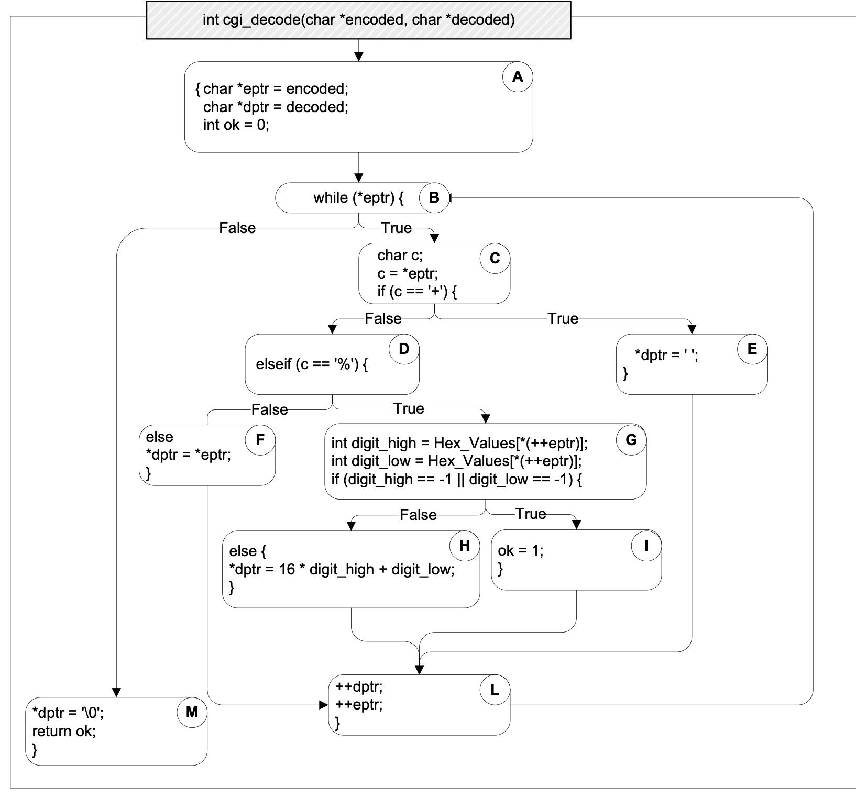

“test”
A
✔
B
✔
C
✔
D
E
✔
F
✔
G
H
I
✔
L
M
✔
Notes:
Let’s apply this to the cgi_decode example. Here block is code is highlighted in a rectangle (or a node in a tree) and then paths are liked edges of the tree
The initial coverage is 7/11 blocks = 63%.
(We could also count the statements instead (here: 14/20 = 70%), but conceptually, this makes no difference)

Slide 19
“test”
A
“a+b”
✔
B
✔
C
✔
D
E
✔
✔
F
✔
G
H
I
✔
L
M
✔
Notes:
and the coverage increases with each additionally executed statement…
if we add the second test, coverage increases to 72%

Slide 20
“test”
A
“a+b”
✔
“%3d”
B
✔
C
✔
D
E
✔
✔
F
✔
G
✔
H
✔
I
✔
L
M
✔
Notes:
Adding the third test increases coverage to 91%

Slide 21
“test”
A
“a+b”
✔
“%3d”
“%g”
B
✔
C
✔
D
E
✔
✔
F
✔
G
✔
H
✔
I
✔
✔
✔
L
M
✔
Notes:
And with adding the last test, we reach 100% block coverage (which is 100% statement coverage, too).

Slide 22
Branch Coverage
Adequacy criterion: each branch in the CFG must be executed at least once
coverage: # executed branches # branches
Subsumes statement testing criterion because traversing all edges implies traversing all nodes
Most widely used criterion in industry
Notes:
Another testing criterion is the branch testing criterion, which states that each branch in the CFG should be executed at least once.
We say that the branch testing criterion subsumes the statement testing criterion
…because if a test suite satisfies the branch testing criterion for a given program, then it also satisfies the statement testing criterion for that program

Slide 23
“+%0d+%4j”
✔
A
B
✔
C
✔
D
E
✔
✔
F
G
✔
H
✔
I
✔
If the conditional fails and the failure case code is missing, statement coverage would still get to 100%, even though there is a defect
✔
L
M
✔
Notes:
Why is branch testing useful?
Let’s consider a buggy version of the same cgi_decode program where block F is missing (CLICK)
Then, the input you see here would achieve 100% statement coverage without ever triggering the defect (CLICK until 100% is displayed
However, if the conditional evaluates to false, we would execute buggy code, so having 100% statement coverage does not mean that the program is free of errors

Slide 24
“+%0d+%4j”
A
B
C
D
E
F
G
H
I
L
M
Notes:
However, if we focus on whether branches have been taken, though, we get a different picture.
Here, we label each branch with “true” or “false”

Slide 25
“+%0d+%4j”
A
B
✔
✔
C
✔
✔
D
E
F
✔
G
✔
✔
H
I
L
M
Notes:
And if we track which branches are executed, we find that the test case executes only 7 out of 8 branches
In other words, branch coverage is 7/8 or 87%.

Slide 26
“+%0d+%4j”
A
“abc”
B
✔
✔
C
✔
✔
D
E
✔
✔
F
G
✔
✔
H
I
L
M
Notes:
If we another test case, such as “abc”, we can cover this remaining branch – and find the defect.

Slide 27
Path Coverage
Sometimes a fault is only manifest on a particular path
E.g., choosing the left branch and then choosing the right branch. (dashed blue path)
But the number of paths can be infinite
E.g., if there is a loop.
There are ways to bound the number of paths to cover.
Notes:
The next testing criterion we consider is path testing
This criterion is not practical because, in the presence of loops, the number of paths may be infinite
Discuss: How do you path independent paths of the graph?
Cyclomatic Complexity can be used to limit the number of paths to cover. It measures the number of linearly-independent paths.
Discuss: How would you test the code with loops in it?
We typically test by running the loops, 0, 1, 2, n-1, n and n+1 times.

Slide 28
Mutation Testing is a way of checking to see whether you’ve tested “enough” paths.
Test framework mutates the code in the SUT
E.g., replacing “&&” with “||” in an “if” statement.
Then we see if the test suite fails.
If the test suite still passes, that means we don’t have enough tests.
Difficult in practice:
Too many mutants possible (time)
Too many mutants are equivalent or uninteresting:
rpc.set_deadline(10); ⟶ rpc.set_deadline(20);
But possible!
https://research.google/pubs/pub46584/
Notes:
<read slide>

Slide 29
100% Coverage may be Impossible
Path coverage (even without loops)
Dependent conditions: if (x) A; B; if (x) C;
Branch coverage
Dead Branches e.g., if (x < 0) A; else if (x == 0) B; else if (x > 0) C;
(x > 0) test will always succeed
Statement coverage
Dead code (e.g., defensive programming)
Notes:
<read slide>

Slide 30
There are many other ways to judge the Adequacy of Structural Tests
Path coverage (usually impossible) implies
Branch Coverage implies
Block Coverage = Statement coverage.
(Other coverage criteria exist, some incomparable)
See https://en.wikipedia.org/wiki/White-box_testing
Notes:
<read slide>
Encourage students to explore the link and see what else is out there

Slide 31
What if the purpose of your test suite is regression testing?
Regression tests control maintenance:
A change cannot be committed until “all” tests pass.
Often “all tests” means “all small automated unit tests”
Adequacy includes whether tests cover all uses:
Uses may include unspecified behavior:
e.g., Users may assume that a hash result is non-negative;
Hyrum’s law: any visible behavior may have dependents.
Users are responsible to add tests:
Beyoncé rule: “If you liked it you should have put a ring test on it” (SoftEng @ Google)
Notes:
<read slide>
An interface should theoretically provide a clear separation between consumers of a system and its implementers. In practice, this theory breaks down as the use of a system grows and its users start to rely upon implementation details intentionally exposed through the interface, or which they divine through regular use. Spolsky’s “Law of Leaky Abstractions” embodies consumers’ reliance upon internal implementation details.
Hyrum law basically says that, if an interface has enough consumers, they will collectively depend on every aspect of the implementation, intentionally or not. This effect serves to constrain changes to the implementation, which must now conform to both the explicitly documented interface, as well as the implicit interface captured by usage. We often refer to this phenomenon as "bug-for-bug compatibility.“
https://www.hyrumslaw.com/

Slide 32

Adequacy of Acceptance Tests
Crucial: meet with prospective customers.
This is difficult, time-consuming and expensive.
But building the wrong product is much worse!
Notes:
<read slide>

Slide 33

Supplement to Acceptance Evaluation
Dogfooding (“Eat your own dogfood”)
Be your own customer.
Weaknesses:
Employees unrepresentative of customers
Whether someone can be compelled to use a product does not say whether they would purchase it.
Notes:
<read slide>

Slide 34

Pareto’s Law
Approximately 80% of defects come from 20% of modules
Notes:
The diagram relates to a principle coined by the Italian economist Vilfredo Pareto in the year 1896 that says “roughly 80% of consequences come from 20% of the causes”
In the scenario of software engineering, Pareto’s Law can be interpreted to say that approximately 80% of defects originates from 20% of modules

Slide 35
Review
Now that you've studied this lesson, you should be able to:
Explain some properties of good tests.
Distinguish flaky, brittle or Mystery tests;
Describe measures of test suite adequacy, and to know their limitations;

